Slide 1


KAZAN URBAN FORUM
How should Kazan avoid the “big” cities mistakes: whose city is it?
Dr John Round
University of Birmingham
Academic lead, International Laboratory for Comparative Urban Studies:
Kazan Federal University

Slide 2
Who am I?
Resident in Moscow and Kazan for the last three years – also spending time in Japan
From Birmingham which is a city similar to Kazan as it is multi ethnic with high levels of tolerance and is transforming its economy from industry towards a diverse approach – with high levels of urban regeneration
An urban geographer who specializes in the use of informal spaces, social networks, state society relations, urban regeneration

Slide 3
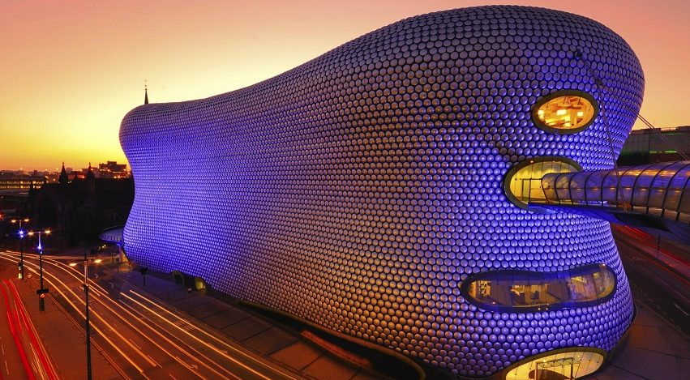

Slide 4
International Laboratory for Comparative Urban Studies:
Kazan Federal University and University of Birmingham
Bringing together social and natural scientists across the university and engaging with government, practitioners, NGOs and the general publics
In collaboration with the University of Birmingham’s School of Geography and Centre for Urban and Regional Studies
Creation of research projects, academic exchanges, dual MA degree
All are invited to take part!

Slide 5
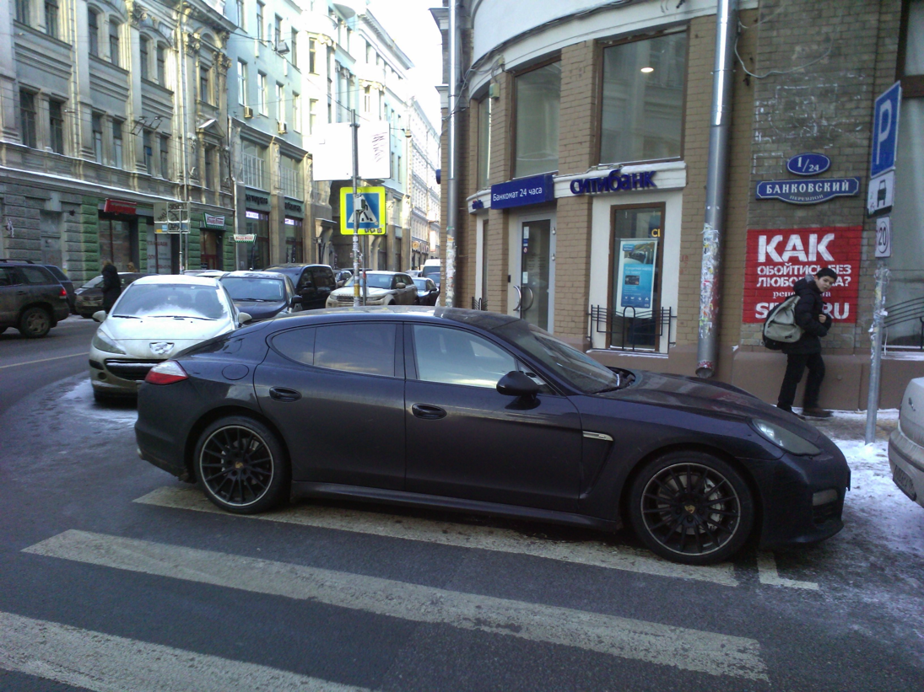
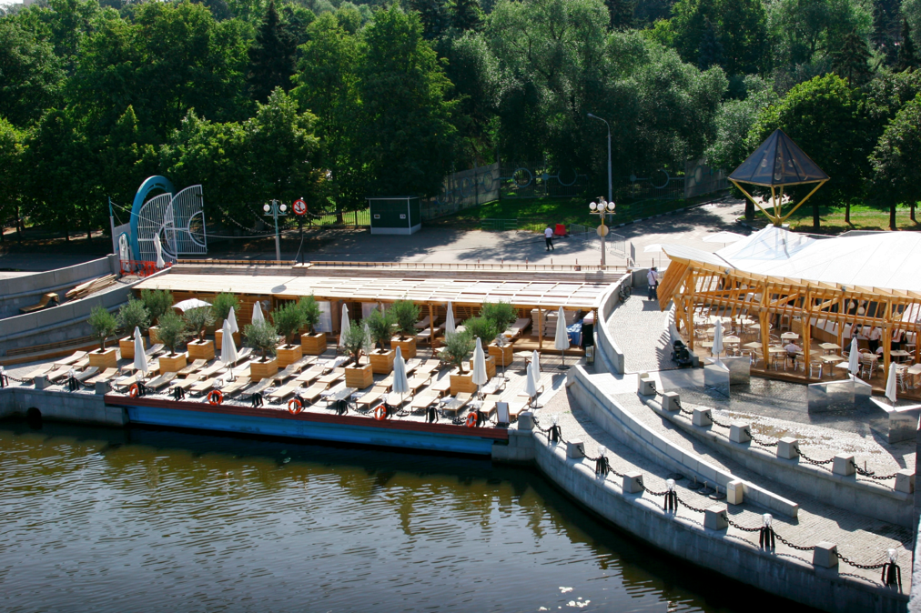
Whose city is it?

Slide 6
Who are the experts?
There is no single ‘off the shelf answer’ for urban development
Too often in Russia geography is ignored – too many western experts coming and saying the answer is bike lanes etc
There needs to be a series of conversations amongst locals, end users, practitioners etc about what the city needs, what order it can be achieved in and how it can be sustained

Slide 7
Who are the competitors?
Kazan needs to think about how to measure success
First the city has to ‘love’ itself and develop a core brand
It cannot compete with Moscow but needs to position itself as a viable alternative for young people
Needs to look south and east as well as west

Slide 8
Who is successful?
Berlin: but rents are rising forcing out those who make it popular – a critique of the creative class.
Austin: again too expensive, too youth orientated
Copenhagen: good balance of who the city is for – expensive
Hi-tech areas: need the absolute ideal environment – not just economic but social and cultural

Slide 9
The resilient city
Central to global urban development debates is the concept of resilience
Taken from biology where it means how a system bounces back from an external shock
Within the social sciences can refer to how regions respond to environmental disasters
Within urban planning adapted to explore how regions/cities can incorporate resilience into planning be it economic, social, environmental etc
Micro resilience on how micro raions, households etc cope with long-term processes

Slide 10
Easy wins
Creating festivals in the city center at different times of year – a Turkish festival in Autumn, German festival in winter, an Ice festival in the New Year – develops links and bring people to the city center and changes the space (cf Birmingham, Sapporo)
Handing over empty spaces in the city center to designers, craft workers, incubators, ‘pop up’ shops (cf Amsterdam)
Pedesterising the city center at weekends – bring people in just to walk – link up Bauman with the lake – subsidize (or sponsor) food, music, street art etc

Slide 11
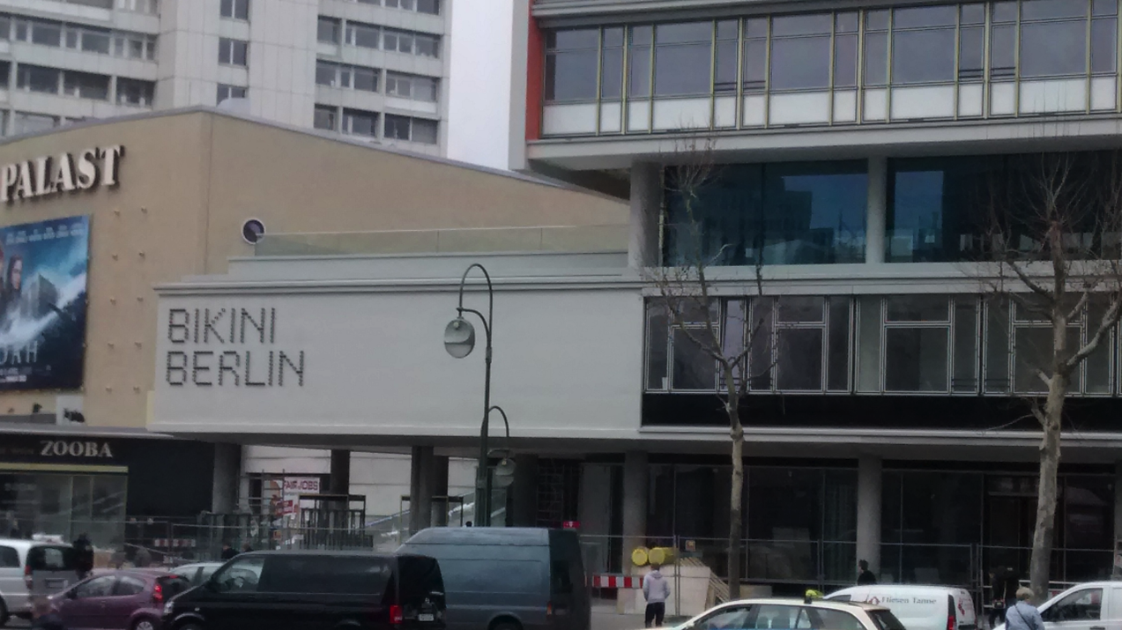
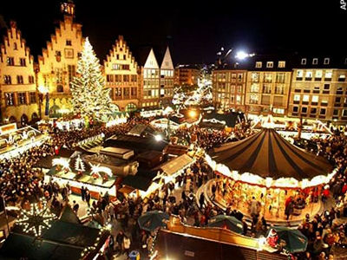
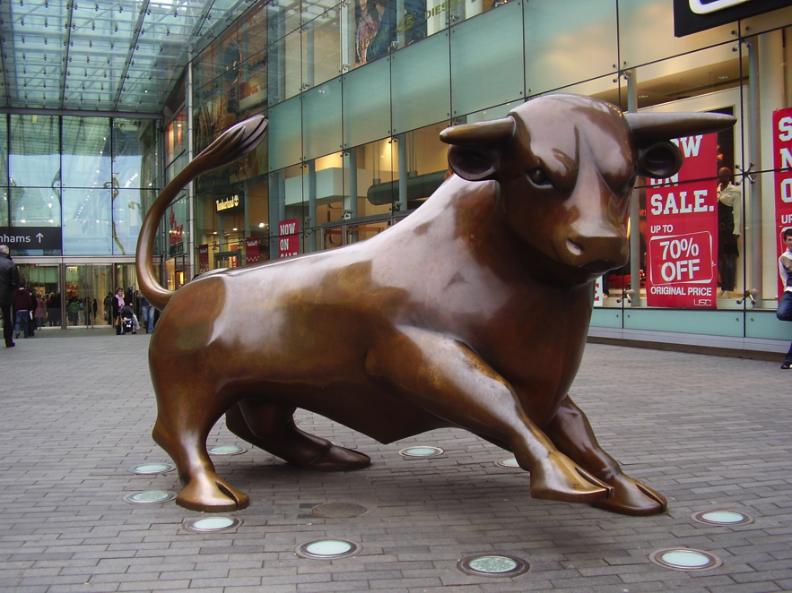

Slide 12
Continue and expand the work done on traffic management in the city
Training for ‘people facing’ staff to create a more welcoming, friendly, city
Develop the multi-ethnic tolerance of the city as a major selling point
Asking people why they like other places! Easy to do – such as when they are waiting for their luggage at the airport
Creating quality of life indicators which don’t just rely on economic statistics – environmental, satisfaction

Slide 13
Who should be involved: everyone
Without a genuine commitment to civic engagement it is impossible to develop a city for long term, resilient, success
Of course economic development is a key goal but it must be much broader than that – to include socio-cultural development, increasing the livability of the city etc
This would place Kazan as a leader amongst Russia’s second tier cities

Slide 14
Ways forward
A series of ‘town hall’ meetings where people can discuss ideas and wishes for the city
The involvement of all groups in society – children, senior citizens, young families etc – and those involved with planning – government officials, practitioners, entrepreneurs, academics etc – through workshops, open calls for ideas, forums
A multi-disciplinary approach to bring together environmental, economic, social, cultural issues and ideas that will make the city stand out in Russia as the first to take a holistic, resilient, approach
Support for ‘city champions’ who will collect ideas and forward them through different channels, such as print and social media
Exchanging ideas with other regions of the world through study trips, case studies, research projects

